Slide 1
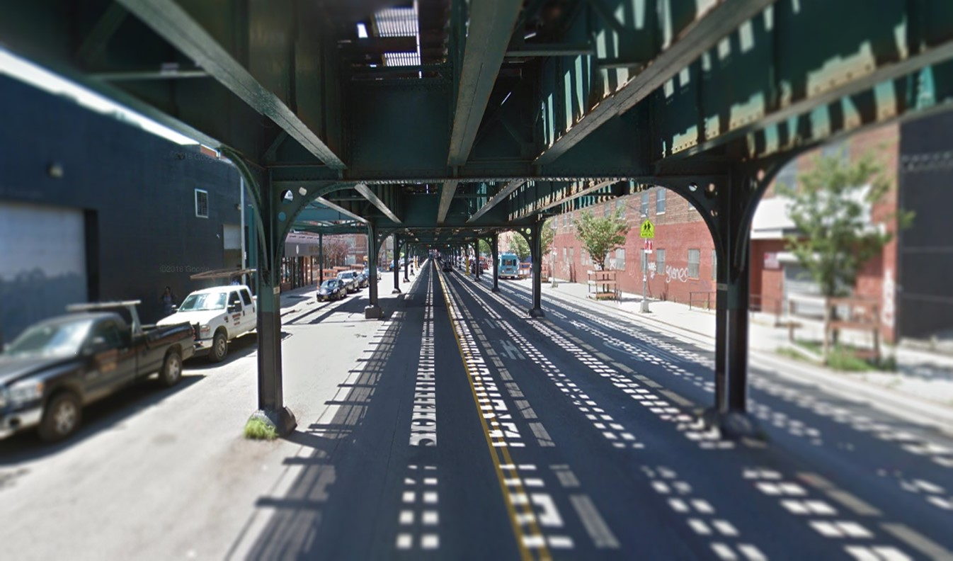
Southern Boulevard TRANSPORTATION Study (draft)

Slide 2
Existing Conditions

Slide 3
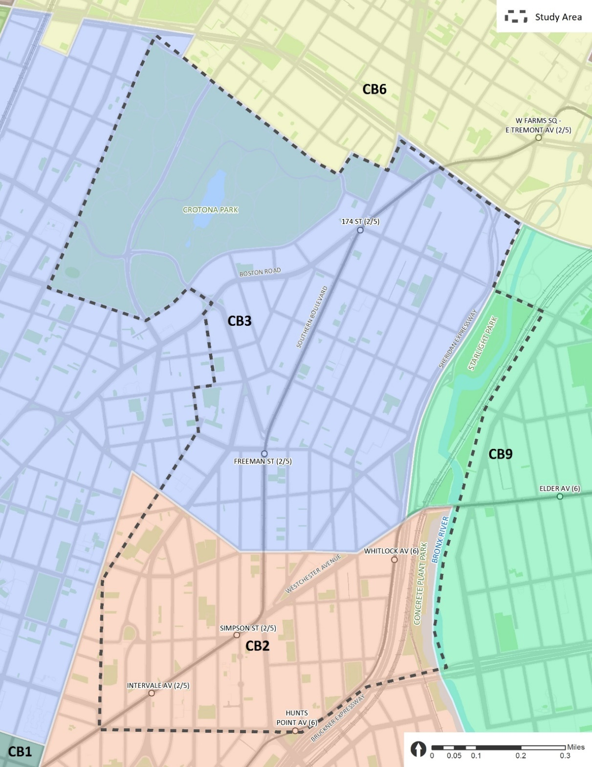
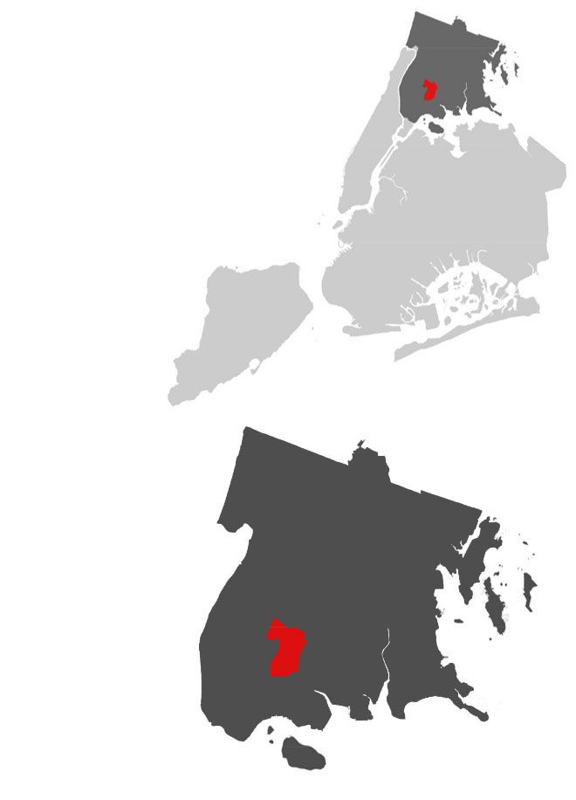
Background
3 Community Districts (CB3, CB2, and CB9)
44,312 Residents
1.07 sq. mi.
41,413 people per sq. mi. (Bronx: 34,168; NYC: 28,173)
Predominantly Hispanic (70%) or Black/African American Non-Hispanic (26%)
Median Household Income: $25,213* (Bronx: $35,302; NYC: $55,191)
NYC
Bronx
Source: 2012-2016 ACS; *weighted average of median household income based on the number of households in each block group (in 2016 dollars)

Slide 4
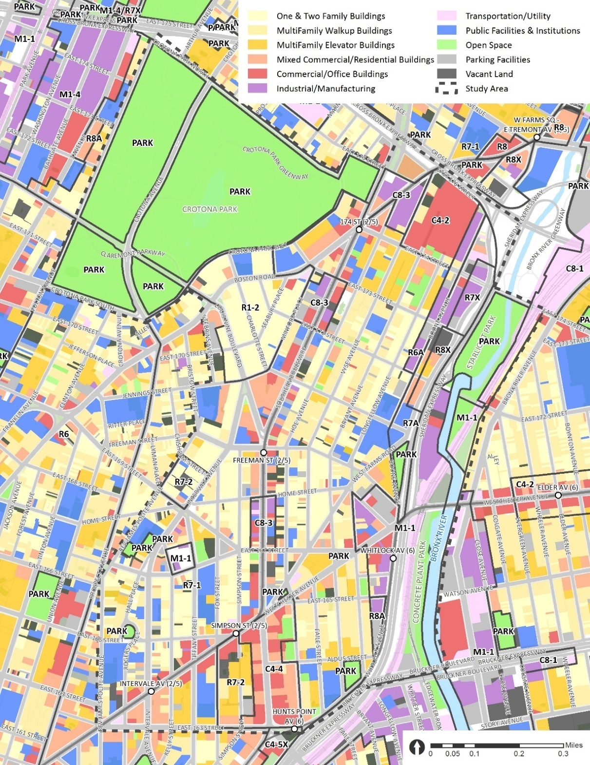
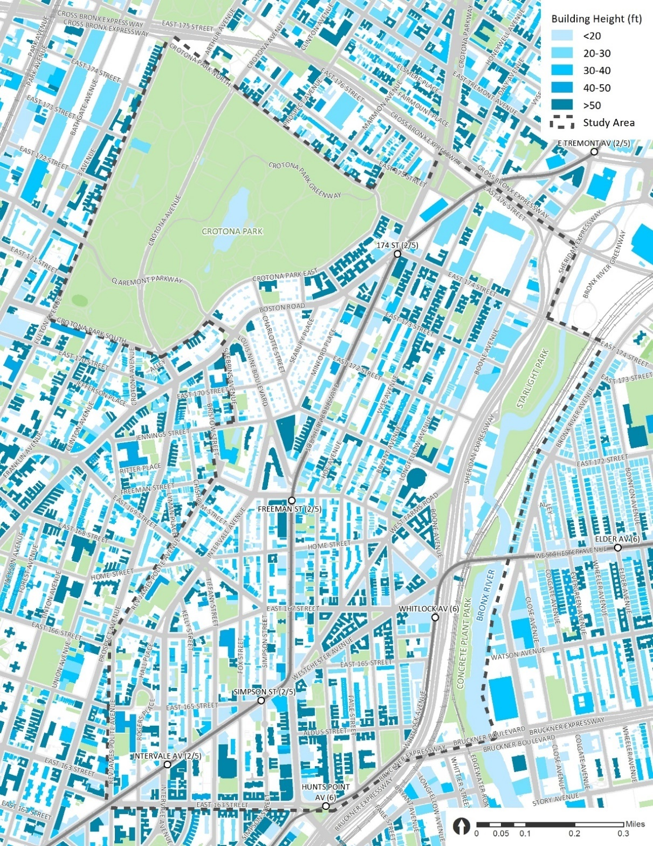
Land Use
Land Use & Zoning
Building Height

Slide 5
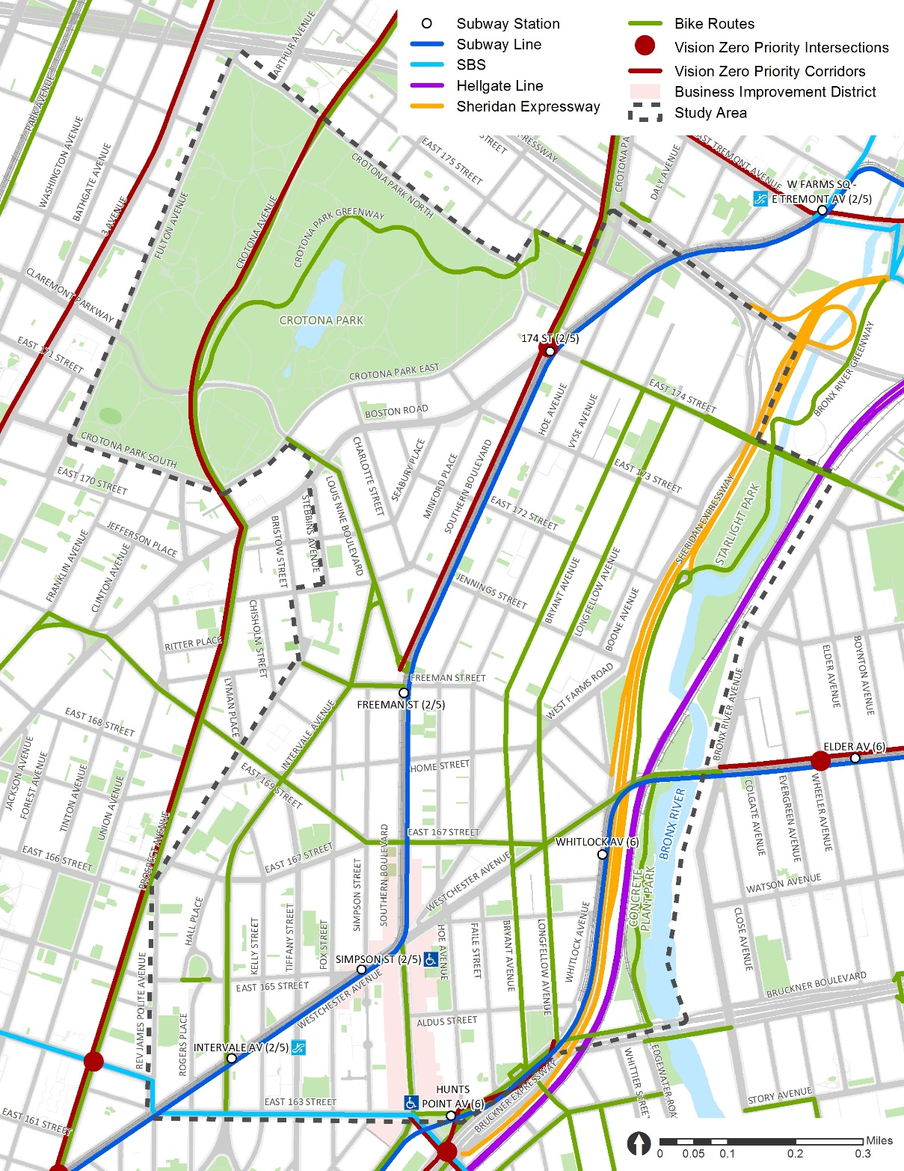
Major Transportation & Open Space Resources
Transit Access
3 elevated subway lines and 6 subway stations (2 with elevators and 2 with escalators)
10 bus routes including a new BX6 Select Service Bus and 95 bus stops
3 major transit hubs: Simpson St, Hunts Point Ave, and West Farms Sq (just outside study area)
21 bus stops under the els
Open Space and Bicycle Network
Crotona Park (127.5 acres; “Central Park"’ of the South Bronx; 3.3-acre lake; largest pool in the Bronx; 20 tennis courts)
Bronx River parks (Starlight Park + Concrete Plant Park)
1.7 miles greenways; 4 miles standard bicycle lanes; 0.6 mile shared lane; 1.7 miles signed routes
Vision Zero
1 Vision Zero Priority Intersection (Southern Blvd @ Boston Rd @ 174 St)
2 Vision Zero Priority Corridors (Crotona Ave + Southern Blvd)
Major Future Improvement
Sheridan Expressway “Boulevardization”: Sheridan Expressway is planned to be transformed into a neighborhood boulevard to better connect the neighborhood and the Bronx River waterfront with three planned crossings
Penn Station Access: using existing Amtrak Hellgate Line to open a new Metro-North Railroad link between Penn Station and New Haven Line with 4 new stations in the Bronx including Hunts Point station
Crotona Park
Planned Crossing
Planned Crossing
Planned Crossing
Sheridan Expy
Bronx River
New Metro North Station
NYSDOT Sheridan Projects: https://www.dot.ny.gov/southbronx/sheridan; https://www.dot.ny.gov/southbronx/hunts-point
Penn Station Access: http://web.mta.info/mta/planning/psas/

Slide 6
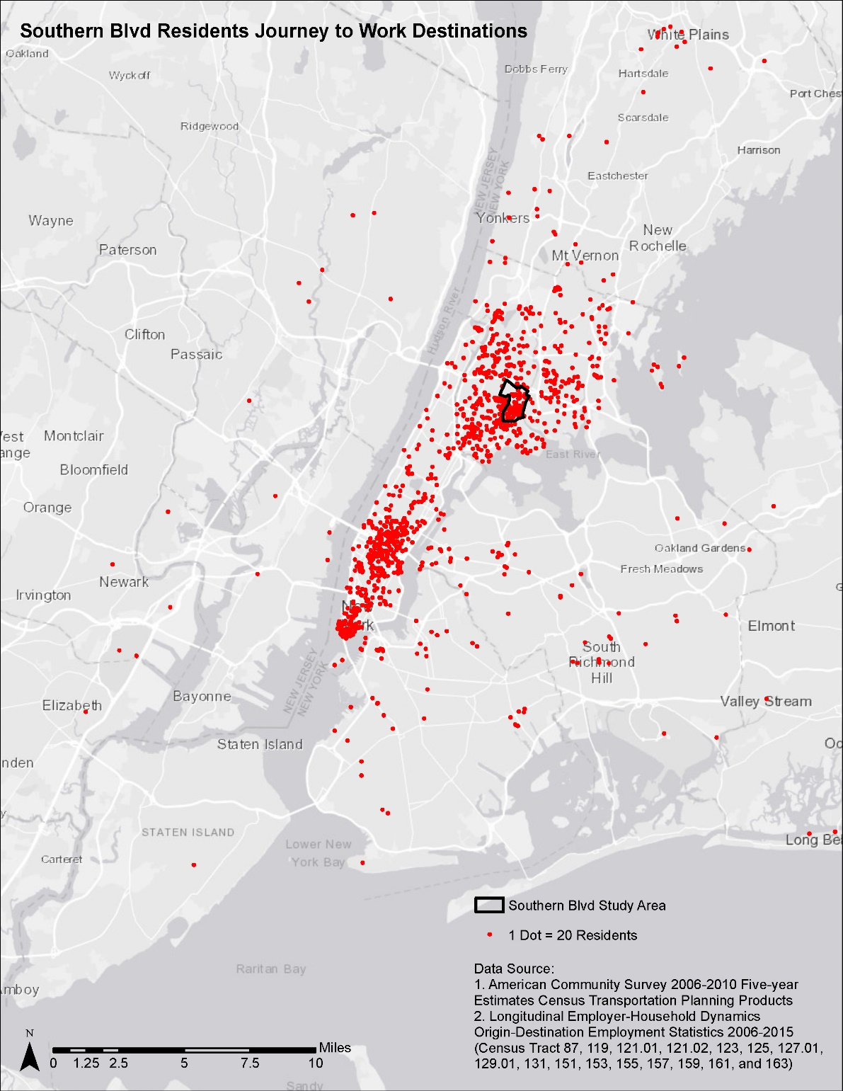
Commuting Characteristics (Residents)
Bronx | 46%
Manhattan | 37%
Other NYC | 10%
Outside NYC | 7%
Source: 2012-2016 ACS

Slide 7
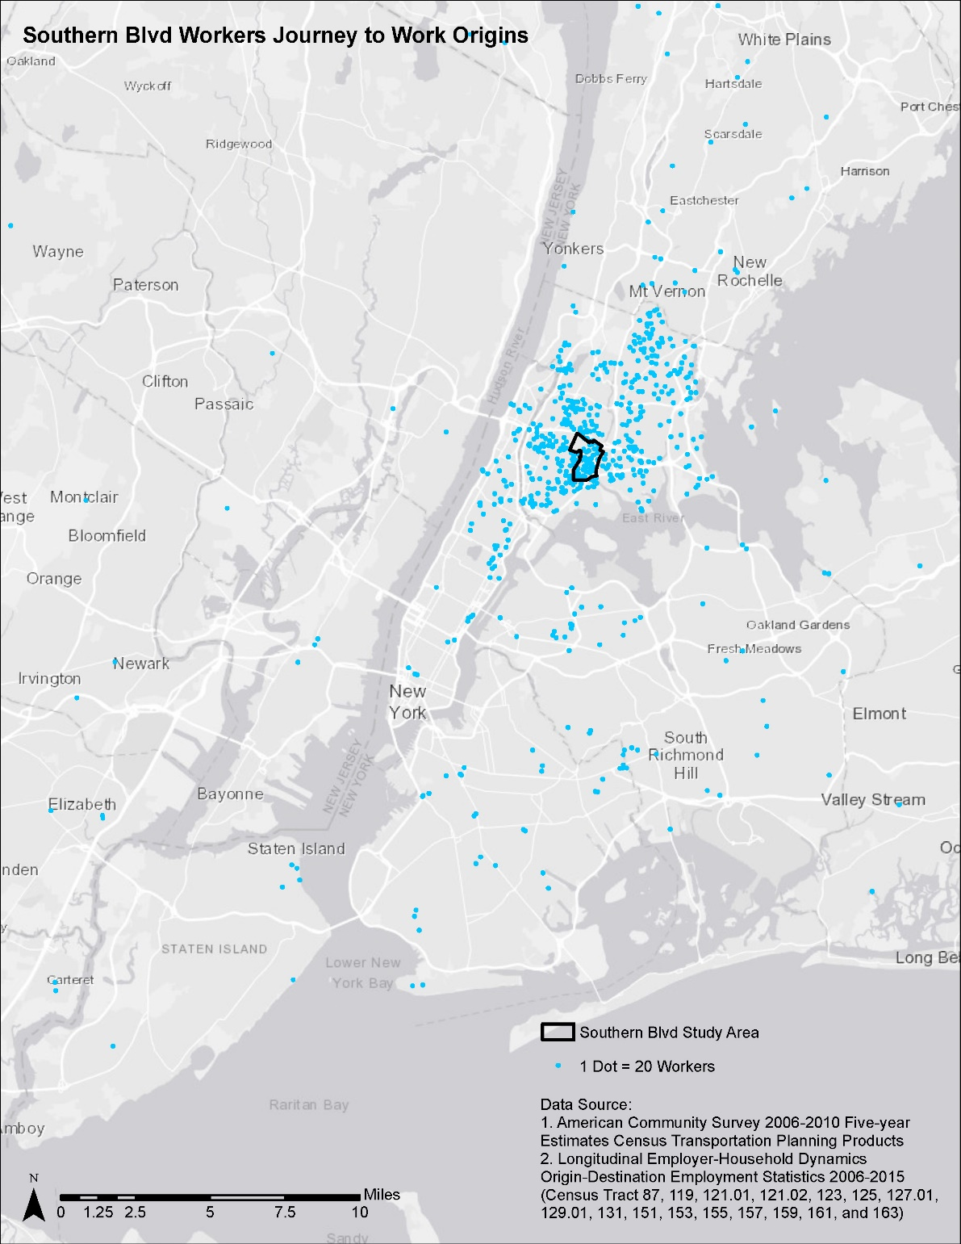
Commuting Characteristics (Workers)
Bronx | 63%
Manhattan | 10%
Other NYC | 13%
Outside NYC | 15%
Source: *CTPP 2006-2010; ** ACS 2012-2016

Slide 8
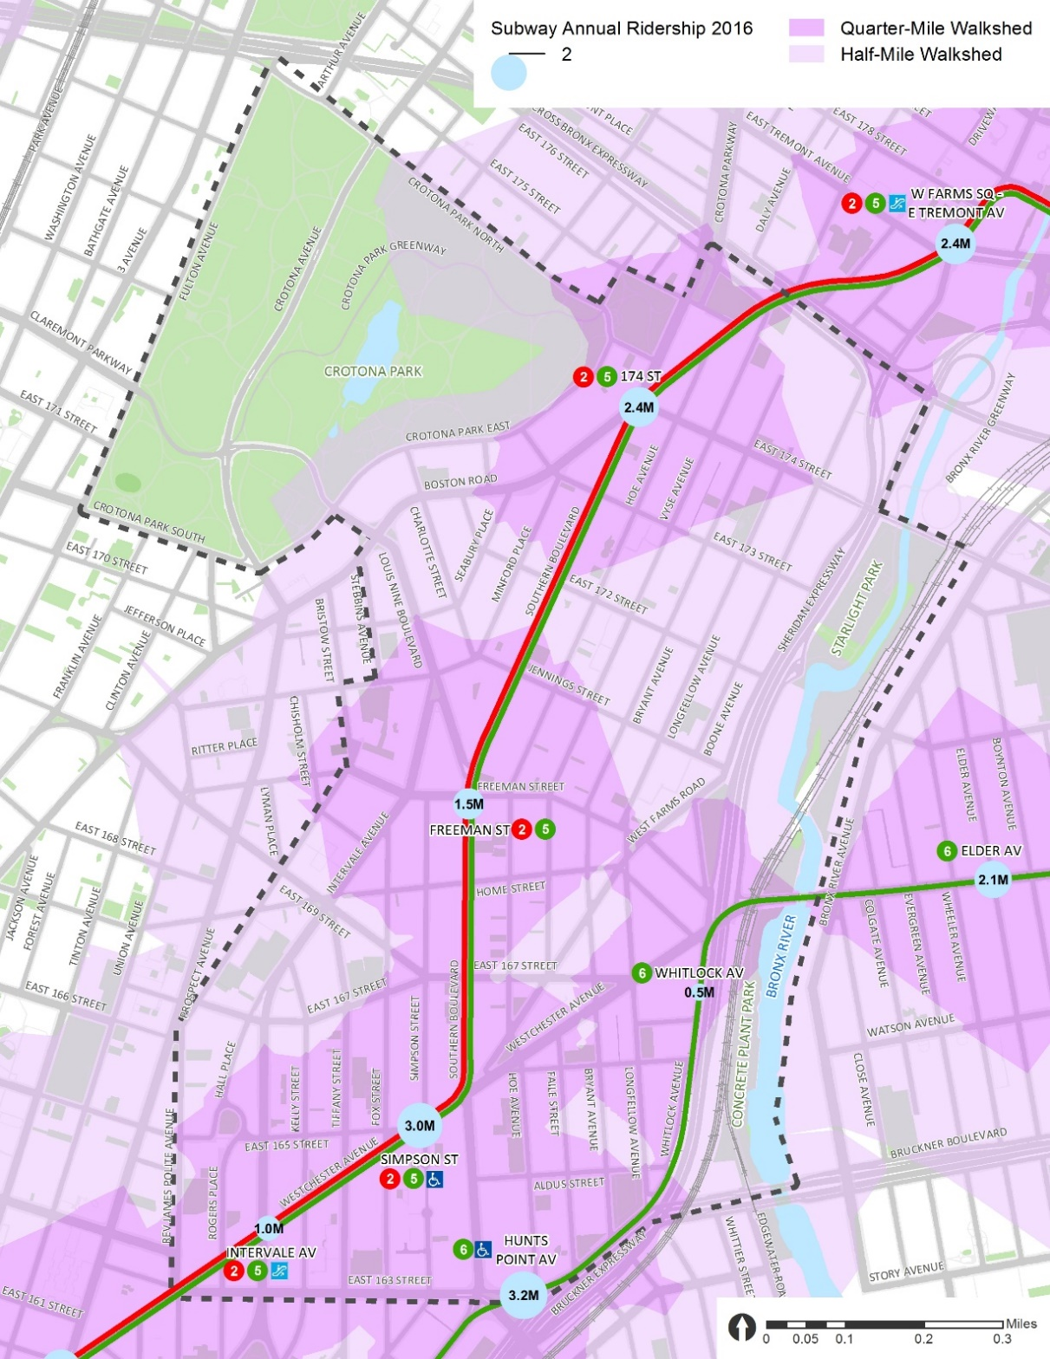
Subway
2/5 Train
Intervale Ave (Escalator)
Simpson St (Elevator)
Freeman St
174 St
6 Train
Hunts Point Ave (Elevator)
Whitlock Ave
Subway Station | Annual Ridership (2012) | Annual Ridership (2016) | % Change (2011-2016)
Intervale Ave (2/5) | 937,280 | 1,061,240 | 13.2%
Simpson St (2/5) | 2,810,789 | 3,046,838 | 8.4%
Freeman St (2/5) | 1,393,186 | 1,588,448 | 14.0%
174 St (2/5) | 2,152,009 | 2,411,413 | 12.1%
Hunts Point Ave (6) | 3,204,779 | 3,269,585 | 2.0%
Whitlock Ave (6) | 524,988 | 571,352 | 8.8%
Bronx | 145,029,400 | 153,079,012 | 5.6%
System Total | 1,654,582,265 | 1,756,814,800 | 6.2%
Source: http://web.mta.info/nyct/facts/ridership/ridership_sub_annual.htm

Slide 9
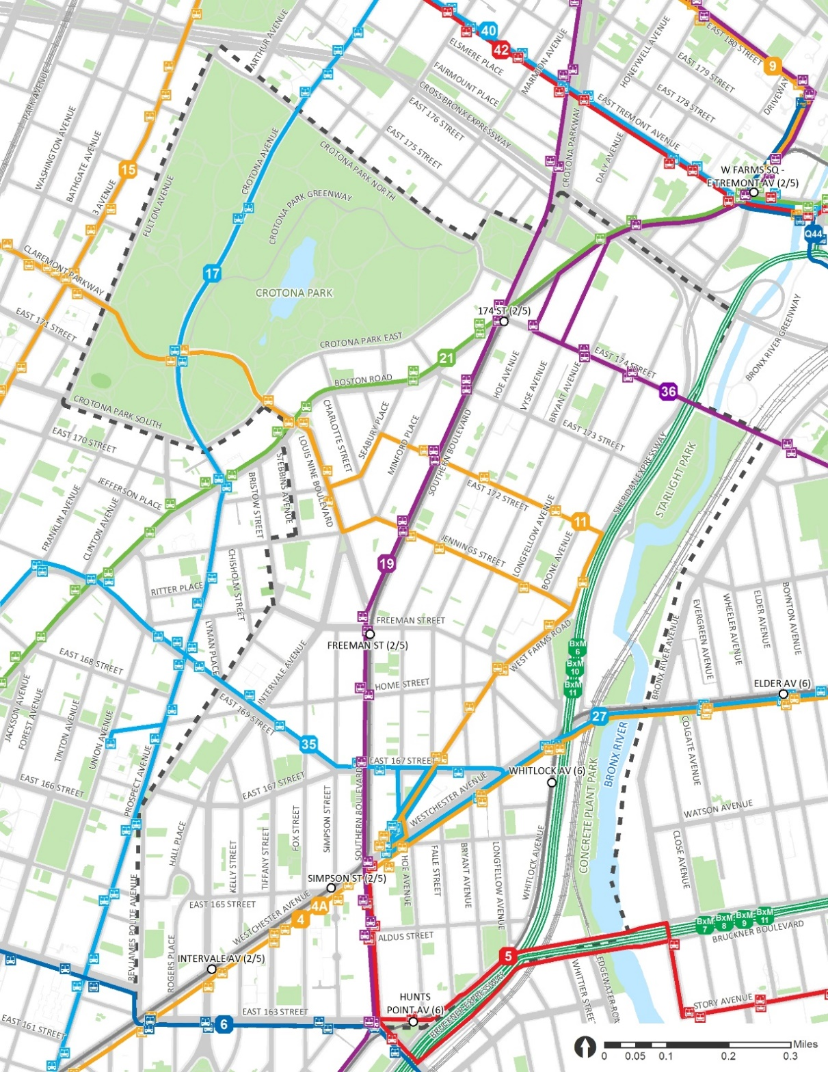
Bus
Bx4/4A (The Hub ⬄ Westchester Square)
Bx5 (Pelham Bay Park ⬄ Hunts Point)
Bx6 Local/SBS (Hunts Point, Bronx ⬄ Washington Heights, Manhattan)
Bx11 (Longwood, Bronx ⬄ GW Bridge Bus Station, Manhattan)
Bx17 (Mott Haven ⬄ Fordham Plaza)
Bx19 (NY Botanical Garden, Bronx ⬄ Riverbank State Park, Manhattan)
Bx21 (Westchester Square ⬄ Mott Haven)
Bx27 (Clasons Point ⬄ Soundview or Hunts Point)
Bx35 (Hunts Point, Bronx ⬄ Washington Heights, Manhattan)
Bx36 Local/Limited (Soundview, Bronx ⬄ Washington Heights, Manhattan)
Rank | Bus Stop | Daily Boarding + Alighting (2015)
1 | HUNTS POINT AV/E 163 ST (BX6) | 4,103
2 | W FARMS RD/WESTCHESTER AV (BX35) | 2,734
3 | E 163 ST/HOE AV (BX5) | 2,674
4 | W FARMS RD/HOE AV (BX27) | 2,672
5 | SOUTHERN BL/E 174 ST (BX19) | 1,982
6 | HUNTS POINT AV/SOUTHERN BL (BX5) | 1,976
7 | E 174 ST/BRYANT AV (BX36) | 1,974
8 | SOUTHERN BL/HUNTS POINT AV (BX19) | 1,787
9 | SOUTHERN BL/E 163 ST (BX19) | 1,685
10 | W FARMS RD/WESTCHESTER AV (BX27) | 1,667

Slide 10
Transit Hub
West Farms Sq Transit Hub
Simpson St Transit Hub
Subway: 2/5 Train
Bus Terminal: Bx5, Bx11, Bx27, Bx35
Bus Stop: Bx4/4A, Bx19
Hunts Point Ave Transit Hub
Subway: 6 Train
Bus Stop: Bx5, Bx6 (Local/SBS), Bx19
Rail: future Metro North station
West Farms Sq Transit Hub (just outside of study area)
Subway: 2/5 Train
Bus Terminal: Bx9
Bus Stop: Bx21, Bx36 (Local/Limited), Bx40, Bx42, Q44 (SBS)
Simpson St Transit Hub
Hunts Point Ave Transit Hub

Slide 11
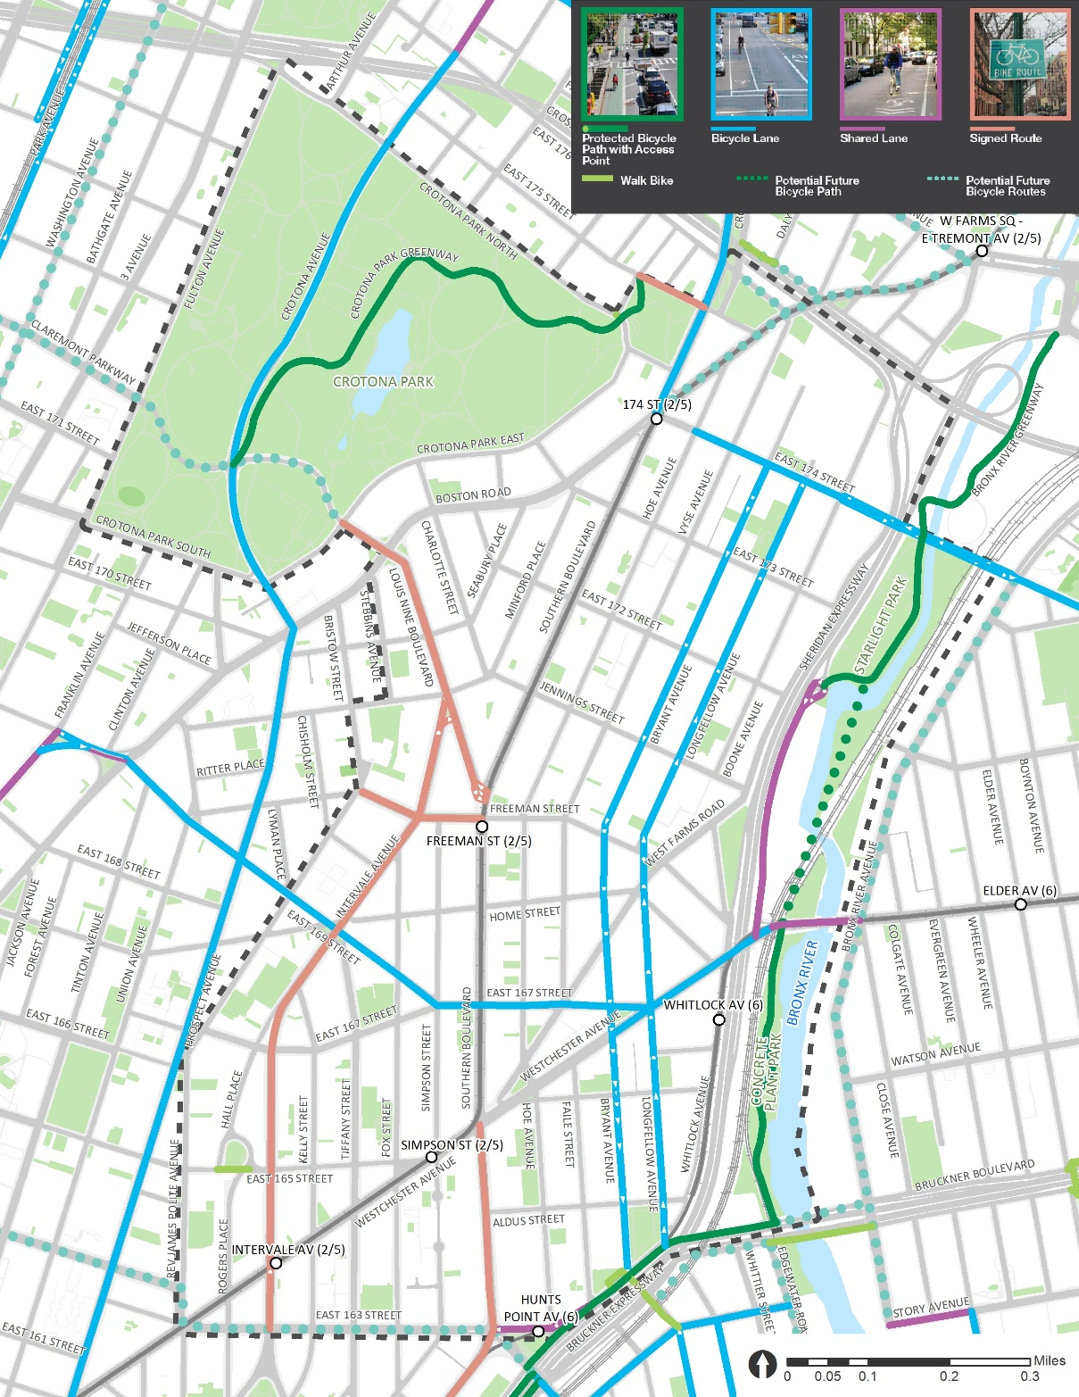
Bicycle
Future / New Bike Connections
Starlight Park / Bronx River Greenway
Bronx River Ave between East 174th St and Westchester Ave
Pedestrian Bridge
Bronx River Ave
Bronx River Greenway
Bronx River Ave
Starlight Park Phase II
Bronx River Ave: http://www.nyc.gov/html/dot/downloads/pdf/bronx-river-ave-may2018.pdf

Slide 12
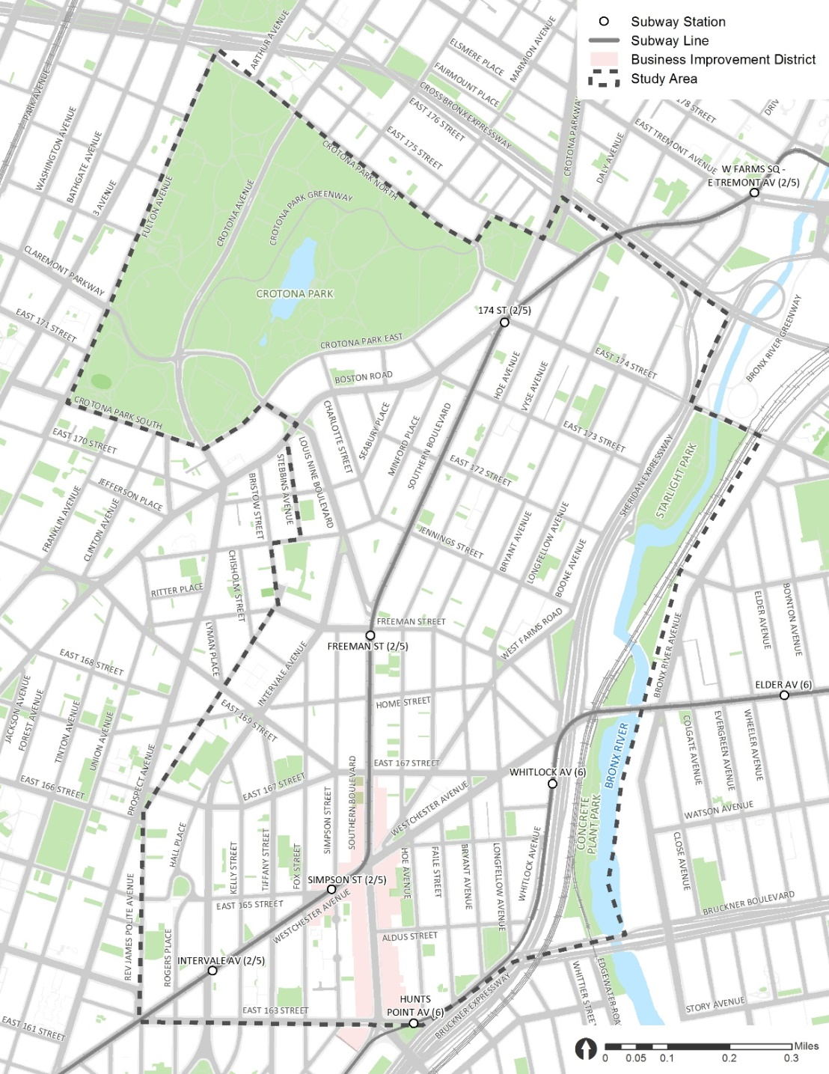

Traffic LOS
Weekday AM Peak
Weekday Midday Peak
Level of Service | Average Control Delay (sec/veh) | General Description (Signalized Intersections)
A | ≤10 | Free Flow
B | >10 – 20 | Stable Flow (slight delays)
C | >20 – 35 | Stable flow (acceptable delays)
D | >35 – 55 | Approaching unstable flow (tolerable delay, occasionally wait through more than one signal cycle before proceeding)
E | >55 – 80 | Unstable flow (intolerable delay)
F | >80 | Forced flow (jammed)
C
B
C
B
C
B
B
B
C
E
D
C
C
C
C
D
C
B
B
D
D
E

Slide 13
Traffic LOS
Weekday PM Peak
Saturday Midday Peak
Level of Service | Average Control Delay (sec/veh) | General Description (Signalized Intersections)
A | ≤10 | Free Flow
B | >10 – 20 | Stable Flow (slight delays)
C | >20 – 35 | Stable flow (acceptable delays)
D | >35 – 55 | Approaching unstable flow (tolerable delay, occasionally wait through more than one signal cycle before proceeding)
E | >55 – 80 | Unstable flow (intolerable delay)
F | >80 | Forced flow (jammed)
C
C
C
C
B
B
B
B
C
B
C
C
C
C
D
C
B
B
D
C
E

Slide 14
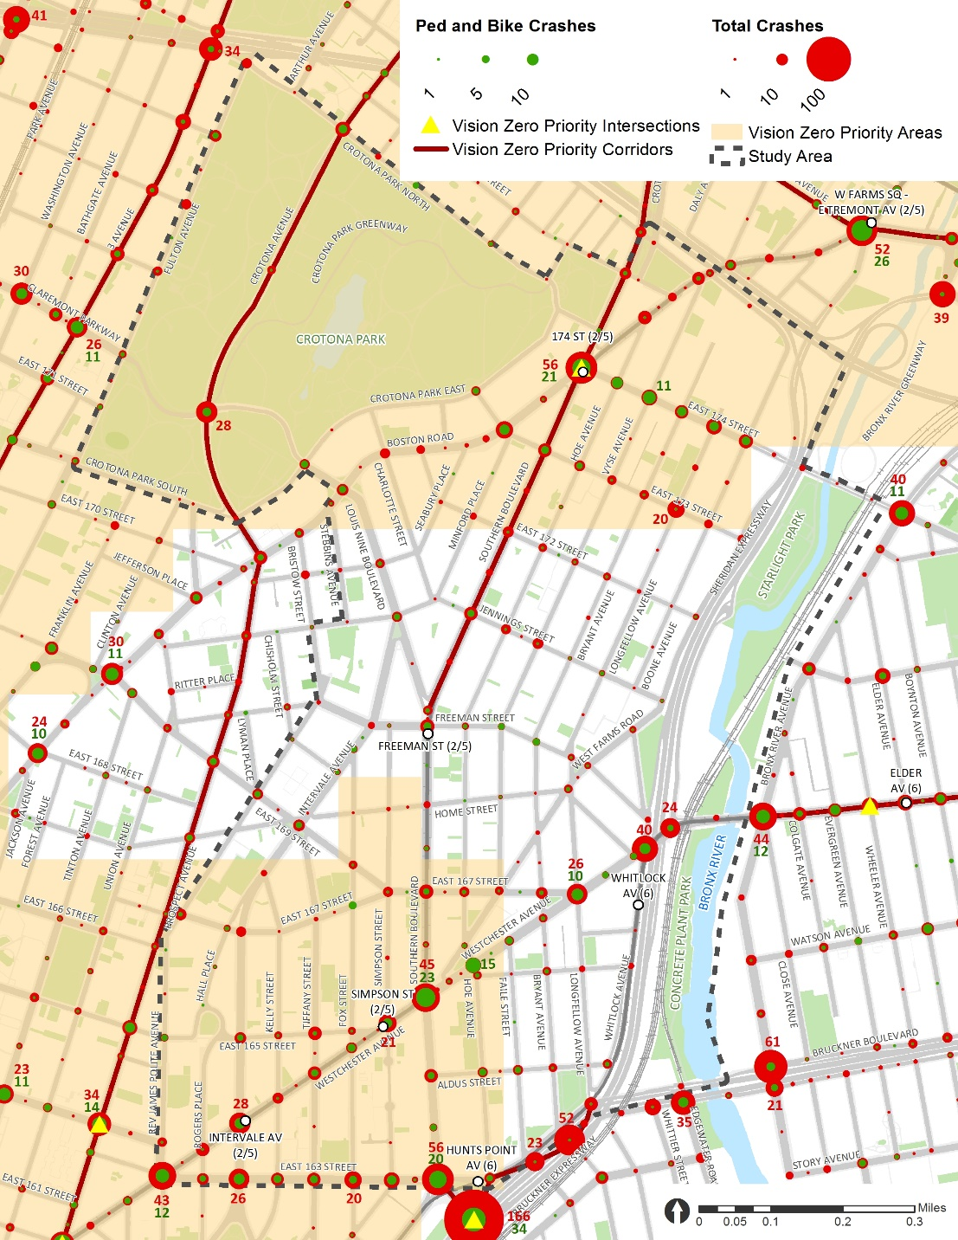
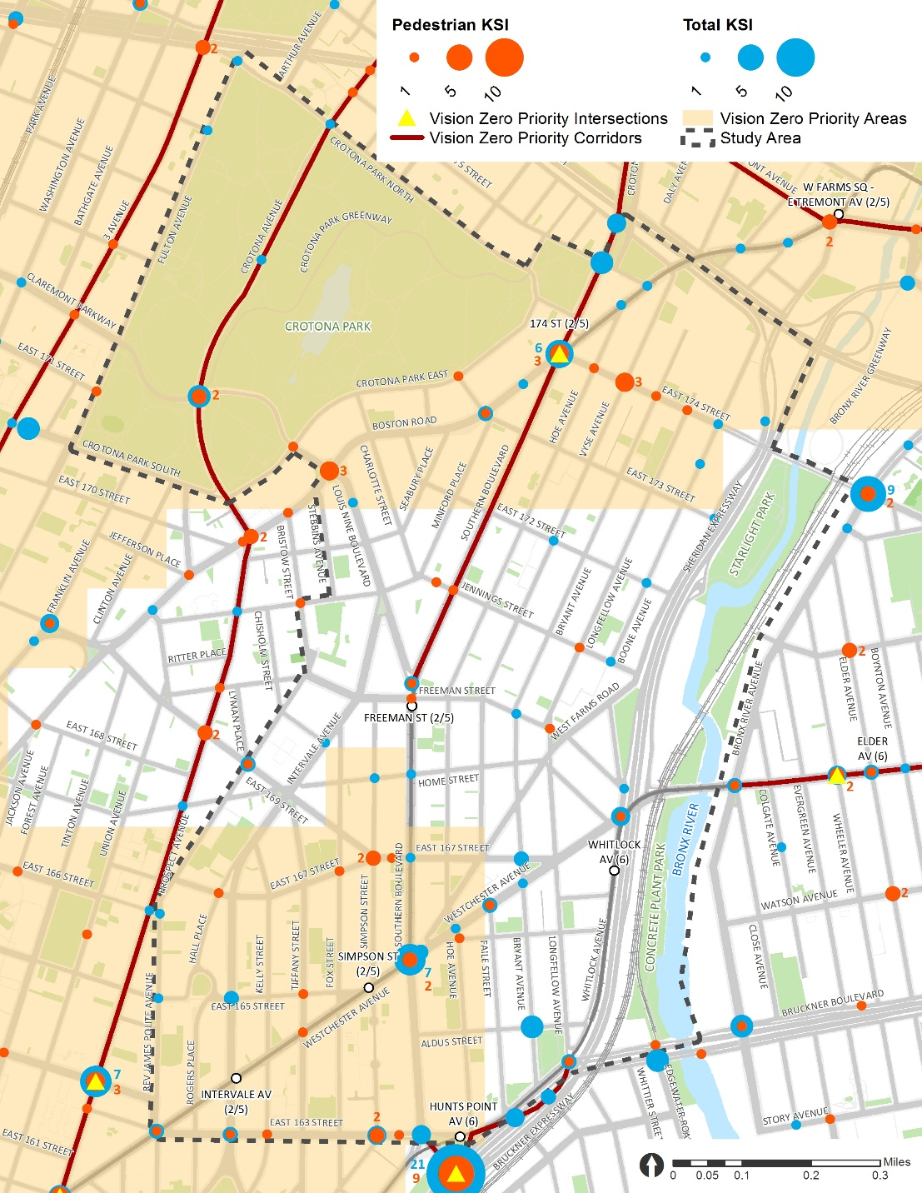
Crash & KSI
Crash 2012-2016
KSI 2012-2016
**
*KSI = Number of Killed or Severely Injured persons in crashes
**DOT uses pedestrian KSI to identify Vision Zero Priority Intersections, Corridors and Areas

Slide 15
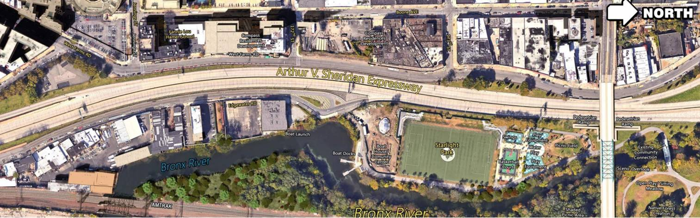
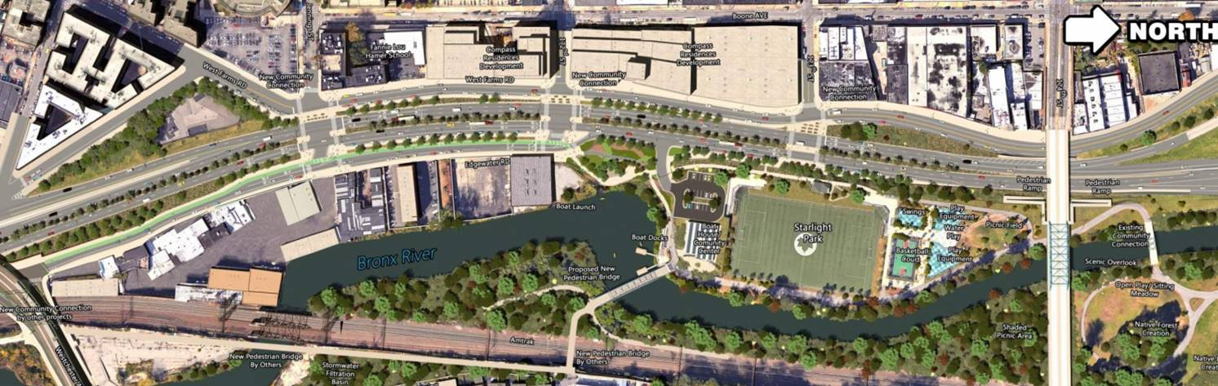
NYSDOT Arthur Sheridan Enhancement Project
Existing Condition
Introduce three signalized at-grade intersections for pedestrian and bicycle crossings
Convert Edgewater Rd. to a one-way street, add a two-way protected bicycle lane, and provide access to Southbound Sheridan
Convert West Farms Road to one-way southbound between 173rd St and Jennings St
Construct a pedestrian bridge over the Bronx River within Starlight Park
Provide two lane exit ramp at Westchester Ave from Southbound Sheridan
Improve landscaping, drainage, traffic signals, pavement and lighting on the Sheridan
Create a public space at the entrance to Starlight Park
Provide parking along northbound Sheridan
Proposed
NYSDOT Arthur Sheridan Enhancement Project: https://www.dot.ny.gov/southbronx/sheridan
NYSDOT Hunts Point Interstate Access Improvement Project: https://www.dot.ny.gov/southbronx/hunts-point

Slide 16
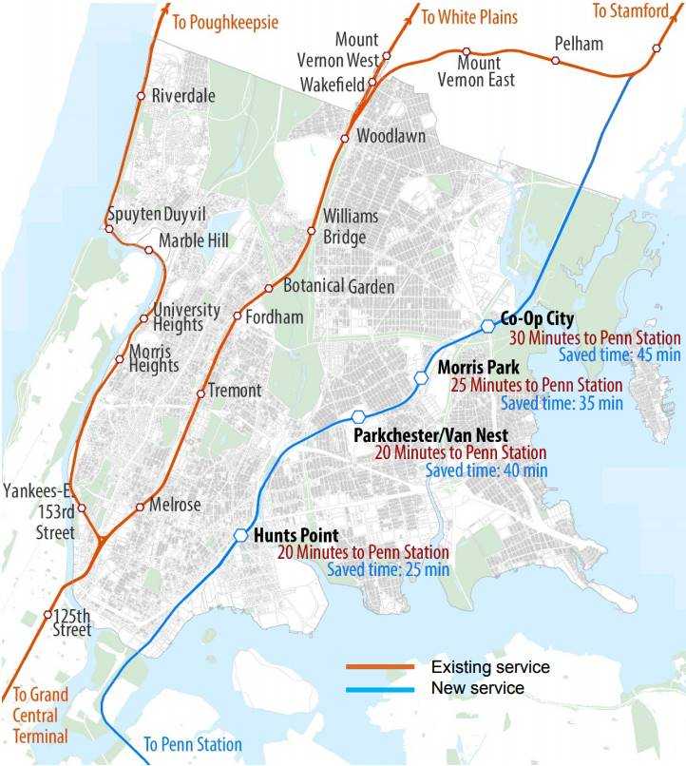
Penn Station Access
Penn Station Access will create a new Metro-North Railroad link directly into Penn Station, providing critical system resiliency to protect service for more than 275,000 daily customers. The project will build four new Metro-North stations in the Bronx. This additional service will:
Substantially reduce travel times to and from Manhattan’s West Side
Introduce convenient, direct rail service to communities underserved by mass transit
Support economic development in the East Bronx
Improve mobility and regional connectivity
Penn Station Access: http://web.mta.info/mta/planning/psas/

Slide 17
Issues and Opportunities

Slide 18

Issues & Opportunities
Under the Els
Parks & Open Space
Louis Nine Blvd Connection
174 St Connection
Crotona Park East
Horseshoe Park Triangle
Southern Blvd BID
Pedestrian Retail Corridor Improvement
Major Intersection Safety Improvement
Reimagine Bus Terminal
Simpson St Triangle Pedestrian Plaza
Westchester Ave Corridor
163 St / Rev James A Polite Ave
Hoe Ave
Longfellow Ave / 167 St
Whitlock Ave
3
2
1
4
3
3
2
2
4
4
1
1

Slide 19
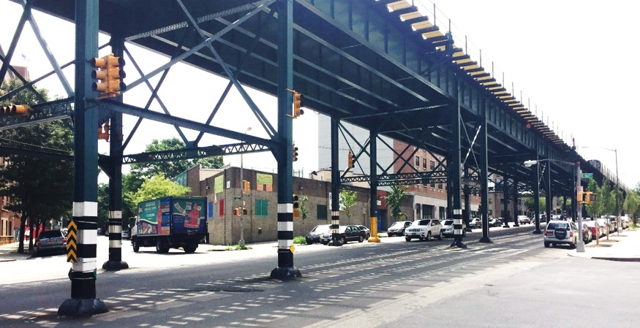
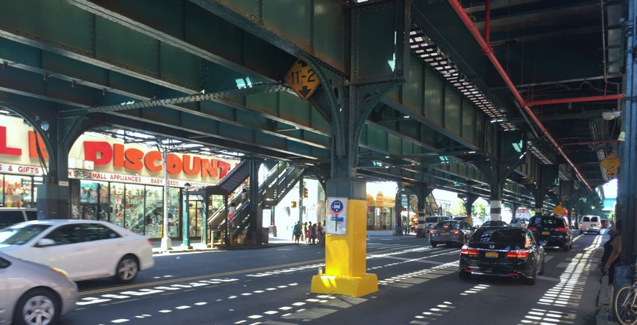
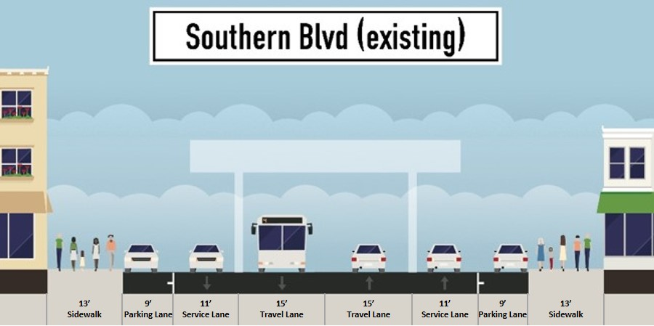
Under the Els
Background
Height varies dramatically
1 travel lane + 1 service lane + 1 parking lane
Fewer than 500 vehicles/hour/direction during the peak period along Southern Blvd and Westchester Ave in 2017
Yellow columns ~ bus stops
~3 to 4 stories
Travel Lane
Service Lane
Parking Lane
Westchester Ave @ 163 St
~1 to 2 stories
Bus Stop with Yellow Column
Westchester Ave @ Simpson St

Slide 20
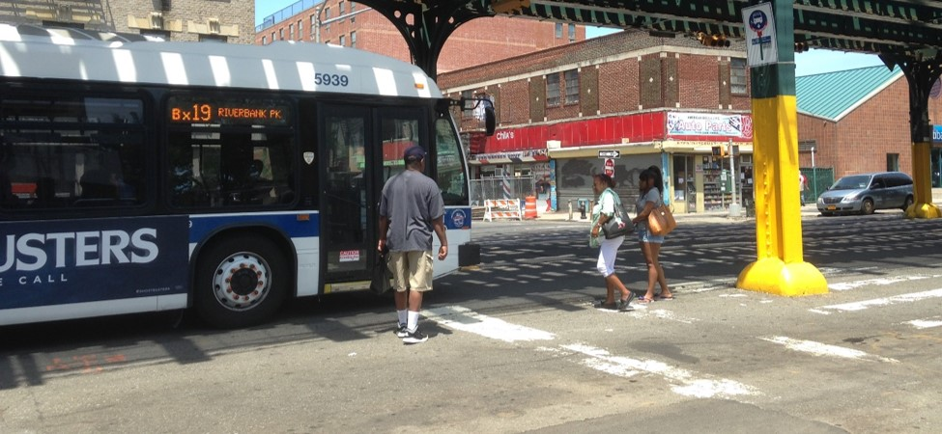
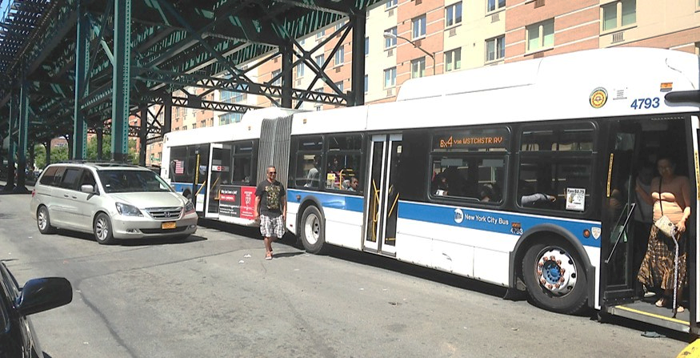
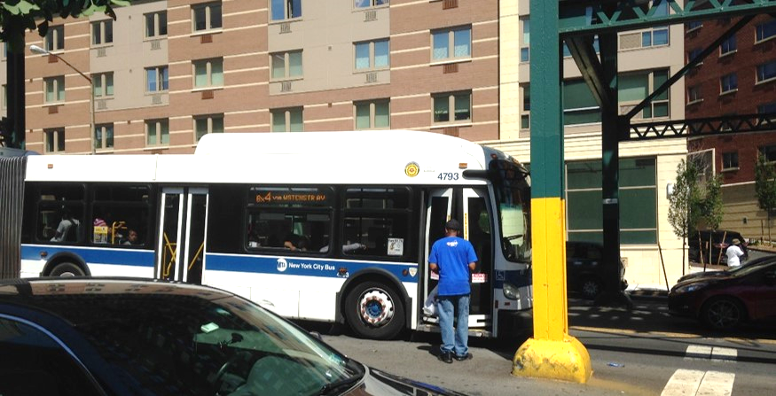
Under the Els
Columns Block Cars’ Visibility of Pedestrians
Issues
Pedestrians are forced to wait, enter and leave the bus in the middle of the street
Turning vehicles weave through the bus stop to make turns or get around a bus
Columns block cars’ visibility of pedestrians
Yellow columns serve as bus stops but no bus stop signs at some locations
Bus Stop in the Middle of the Street
Southern Blvd @ Jennings St
Vehicles in the Service Lane
Passenger
Yellow Column without Bus Stop Sign
Westchester Ave @ 163 St
Passenger
Westchester Ave @ 163 St

Slide 21
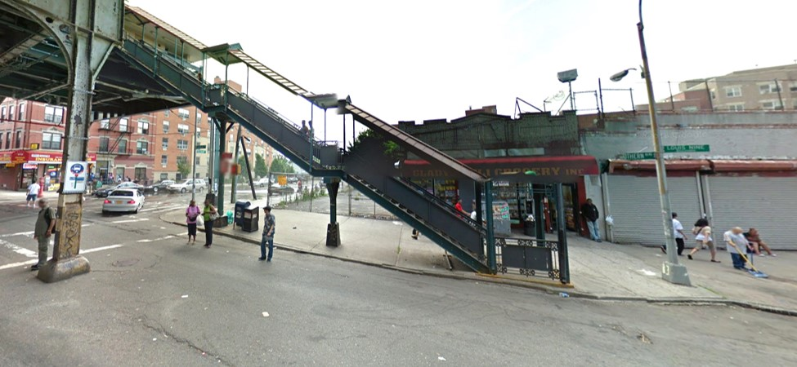
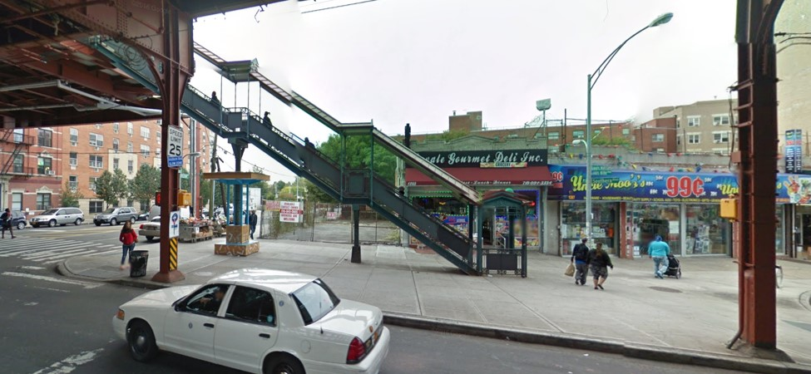
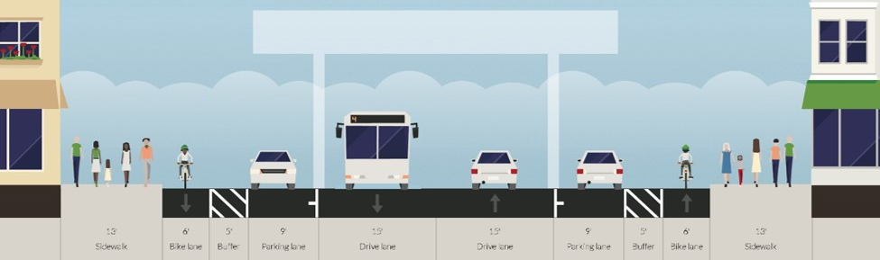
Under the Els
Opportunities
Close outer lanes or add pedestrian island at the bus stops (DOT Bus Stops under the Els projects)
Pedestrian safety improvement throughout the corridor
Install street furniture at the bus stops under the els
Potential bike lanes (close the current service lanes)
Dangerous Bus Stop/
Service Lane
Southern Blvd @ Freeman St (2011)
Bike Lanes under the Els
Street Furniture at the Bus Stop under the El
Safer Bus Stop with Closed Service and Parking Lanes
5’
Buffer
5’
Buffer
Southern Blvd @ Freeman St (2014)
13’
Sidewalk
6’
Bike Lane
9’
Parking Lane
15’
Travel Lane
15’
Travel Lane
9’
Parking Lane
6’
Bike Lane
13’
Sidewalk
DOT Bus Stops under the Els: http://www.nyc.gov/html/dot/html/pedestrians/safertstransit.shtml#bus

Slide 22
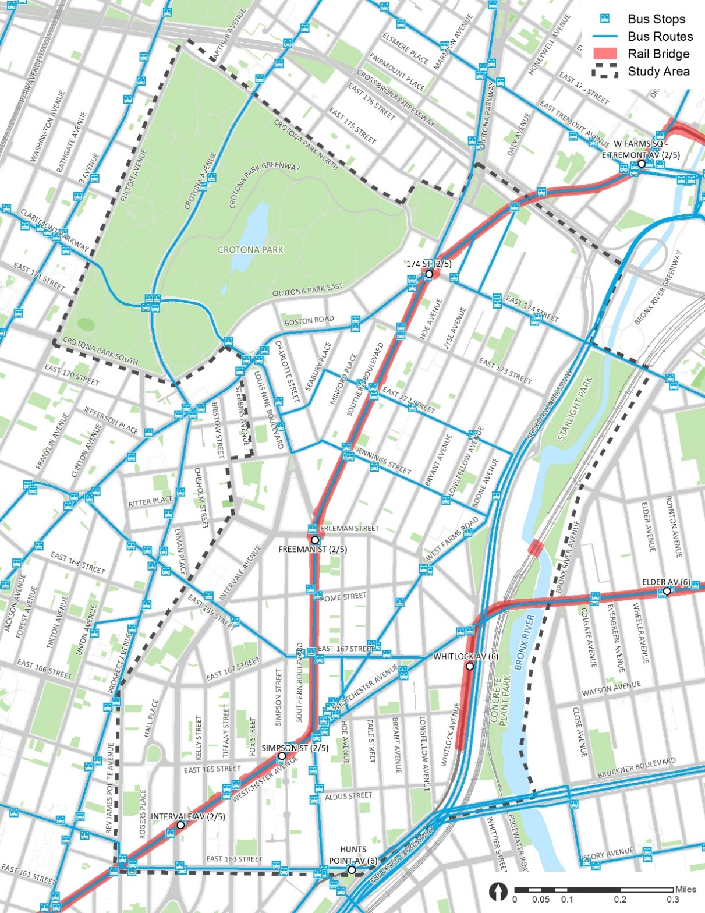
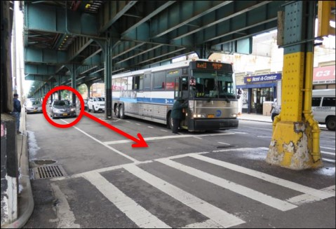
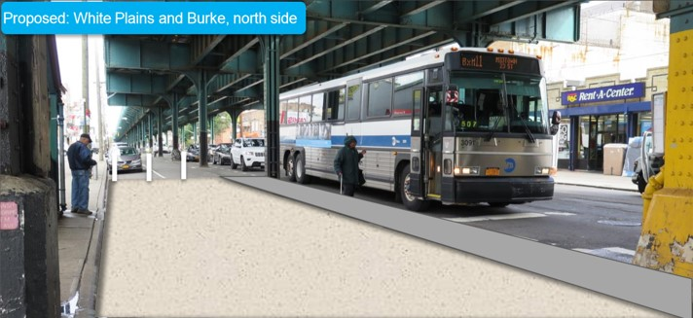
Under the Els
DOT Bus Stops Under the Els Projects
3 completed
Southern Blvd @ Freeman St (Southbound only)
Westchester Ave @ Simpson St (both directions)
1 underway
Southern Blvd @ Boston Rd @ 174 St (construction will begin after DDC sewer and water main capital reconstruction)
17 potential
17 more similar bus stops within the study area (possibly be funded by NDF)
Southern Blvd @ Boston Rd @ 174 St
Southern Blvd @ Freeman St (Southbound)
Example of Bus Islands with Painted Pedestrian Space for Bus Stops under the Els at White Plains Rd @ Burke Ave
Westchester Ave @ Simpson St
Before
After
White Plains Rd at Burke Ave Bus Stop Under the El Improvements (2017):
http://www.nyc.gov/html/dot/downloads/pdf/white-plains-rd-and-burke-ave-dec2017.pdf

Slide 23
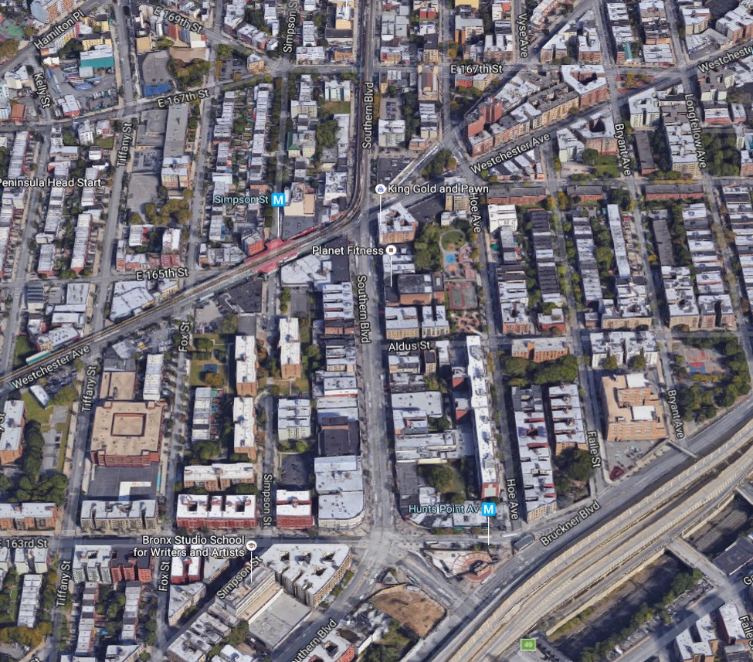
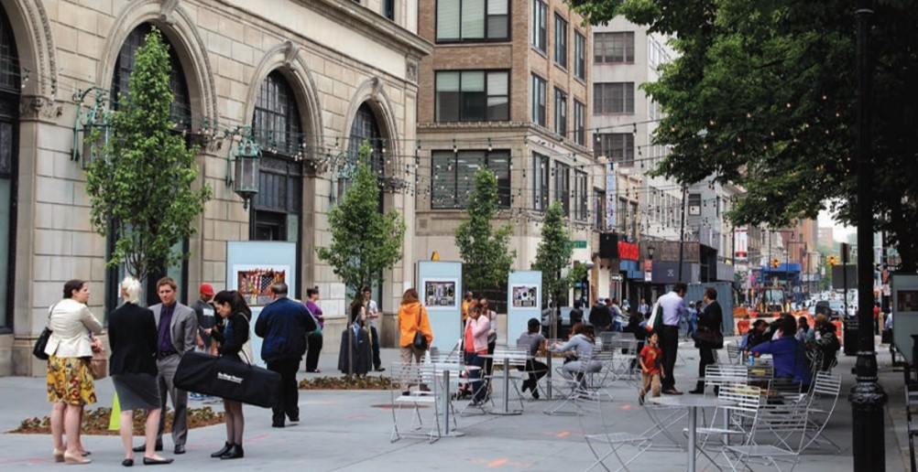
Southern Blvd BID
Business Improvement District (BID)
Community partners, such as BIDs or civic organizations, can help maintain and program the public open spaces that the City plans and creates with input from the local communities
Opportunities in Southern Blvd BID
Pedestrian Retail Corridor Improvement
Major Intersection Safety Improvement
Reimagine Bus Terminal
Simpson St Triangle Pedestrian Plaza
167 St
Bus Terminal
Westchester Ave
Dangerous Intersection
Subway Station
Simpson St Triangle
Pedestrian Retail Corridor
Southern Blvd BID
Southern Blvd
163 St
Del Valle Square + Subway Station
New Metro North Station
Willoughby Plaza in Fulton Mall BID, Brooklyn*
*Source: http://www.nyc.gov/html/dot/downloads/pdf/nycdot-streetdesignmanual-interior-02-geometry.pdf

Slide 24
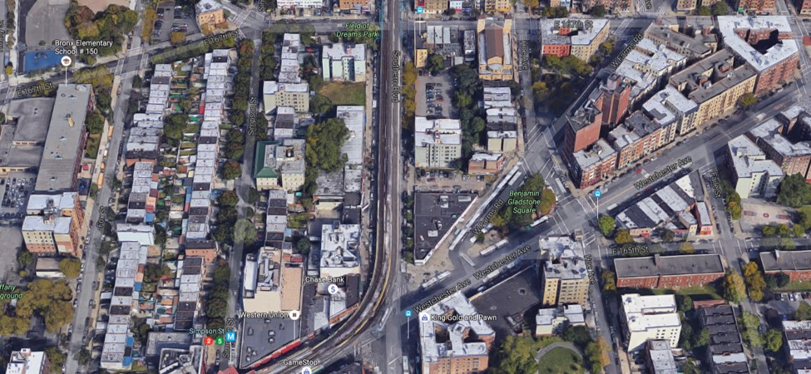
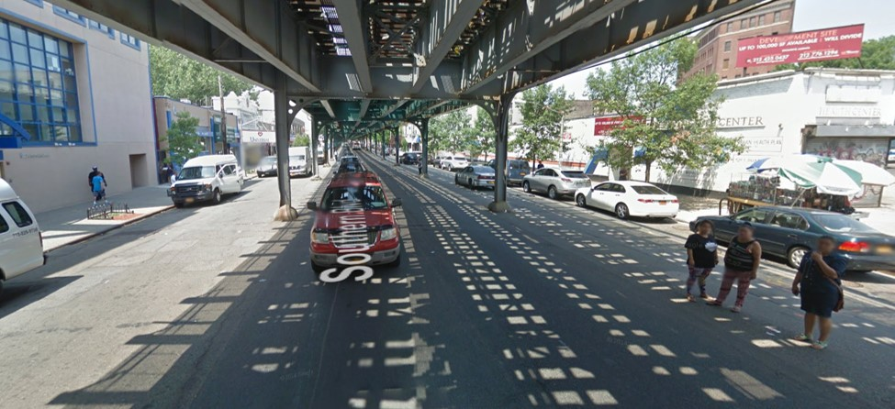
Southern Blvd BID – Pedestrian Retail Corridor Improvement
167 St
Background
Northern portion of Southern Blvd BID
Under the el from 167 St to Westchester Ave
Large vacant lot and parking lot
Issues
Inactive pedestrian retail space
Opportunities
More attractive pedestrian retail space under the el (wider sidewalks, potential bike lanes, etc.)
Potential to redesign the entire bus terminal with surrounding buildings and parks
Vacant Lot
Parking Lot
West Farms Rd
Southern Blvd
Bus Terminal
Southern Blvd BID
Westchester Ave
Simpson St
2
5
Southern Blvd Retail Corridor (167 St – Westchester Ave)
Pedestrian Retail Space Under the El
Southern Blvd between Westchester and 167 St (Facing North)

Slide 25
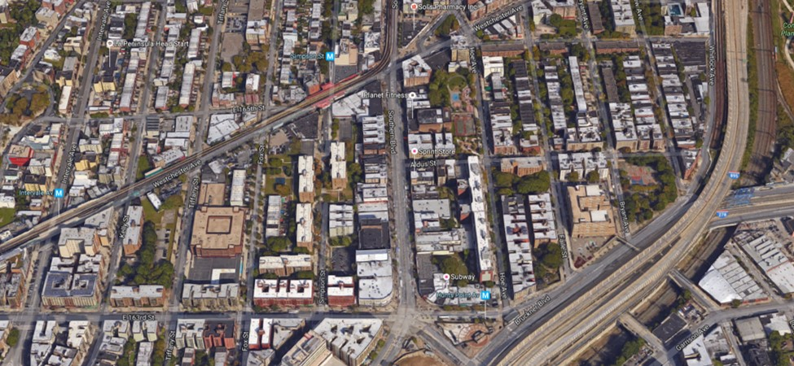
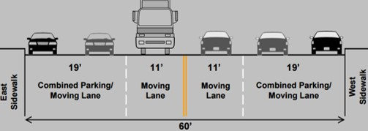
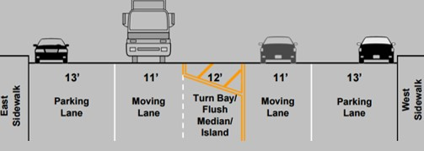
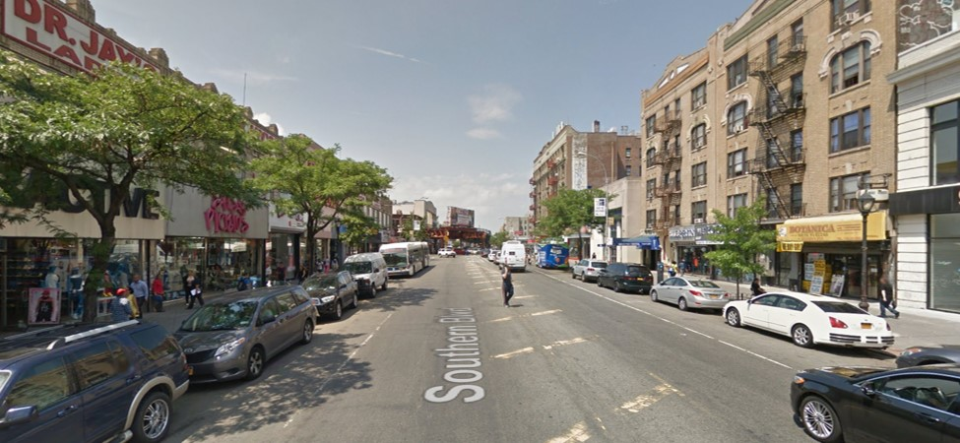
Southern Blvd BID – Pedestrian Retail Corridor Improvement
Bus Terminal
Background
Southern portion of Southern Blvd BID
No el between Westchester Ave and 163 St
Signed bike route
DOT completed project in 2010
Issues
Wide street with lots of double parking, overtaking through striped median, jaywalking, etc.
Opportunities
Add standard bike lane by taking 5’ of the 13’ parking lane
Landscaped median
Pedestrian island on south side of the intersection at Aldus St
Street furniture
Simpson St
2
5
Westchester Ave
Aldus St
Southern Blvd
Before
After
Southern Blvd BID
163 St
Hunts Point Ave
6
Southern Blvd Retail Corridor (Westchester Ave – 163 St)
Wide On-Street Parking Space
Striped Median
Southern Blvd between Westchester Ave and 163 St (Facing North)
Southern Boulevard: Crames Square 2010: http://www.nyc.gov/html/dot/downloads/pdf/20100502_crames-sq_cb2.pdf

Slide 26
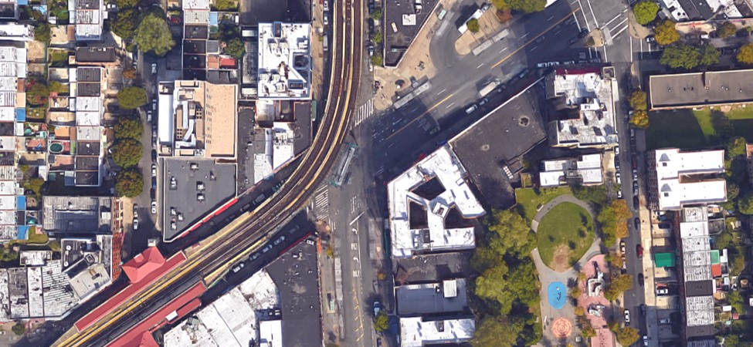
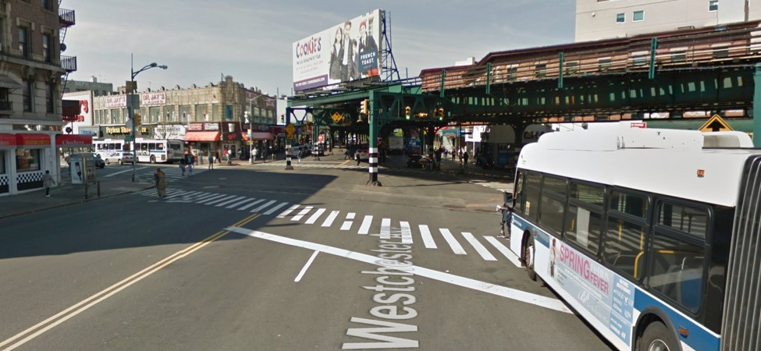
Southern Blvd BID – Major Intersection Safety Improvement
Bx11/Bx27/Bx35/Bx4/Bx4A
Two Lanes for Each Direction
Background
Transit Hub
Simpson St subway station (2/5 train)
Bus Terminal (Bx11/Bx27/Bx35)
Bus Stops (Bx4/Bx4A/Bx5/Bx19)
Southern Blvd BID
45 crashes between 2012 and 2016
51% were pedestrian and bike crashes (21 pedestrian crashes and 2 bike crashes)
Total KSI was 7; pedestrian KSI was 2
Issues
Columns in the middle of the intersection
85 feet long pedestrian crossing
Westbound merging from two lanes to one lane
Opportunities
Curb extensions to shorten the long pedestrian crossings
Markings and signs to guide the vehicles
Southern Blvd
85 Feet Long Pedestrian Crossing
Bx4/
Bx4A
Column
Column
One Lane for Each Direction
Bx5/Bx19
Simpson St
Southern Blvd BID
2
5
Westchester Ave
Bx5/Bx19
Column
Column
85 Feet Long Pedestrian Crossing
Southern Blvd @ Westchester Ave (Facing West)

Slide 27
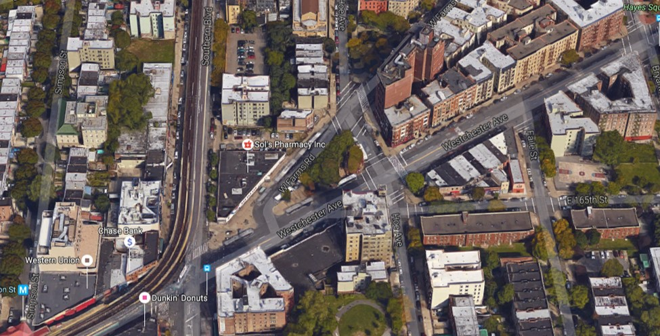
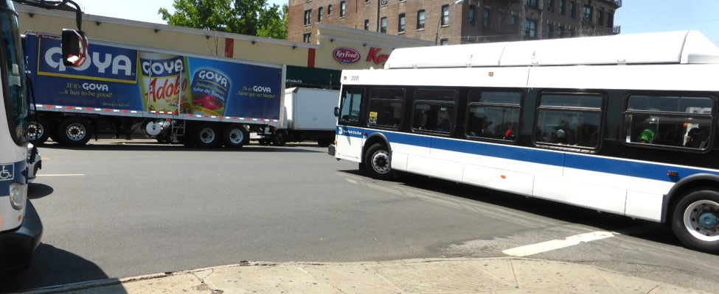
Southern Blvd BID – Reimagine Bus Terminal
Background
Bus Terminal (Bx11/Bx27/Bx35)
Bus Stop (Bx4/Bx4A)
Issues
Buses inch out and turn left at the unsignalized intersection
Opportunities
Option 1: Add a traffic signal coordinated with the signal timing of Westchester Ave @ Southern Blvd
Option 2: Reverse the loop direction
Option 3: Signal timing modifications for the signals at Westchester Ave @ Southern Blvd and Westchester Ave @ Hoe Ave to create gaps for buses turning left
Option 4: Redesign the entire bus terminal with the surrounding buildings and parks
Hoe Ave
West Farms Rd
Southern Blvd
Westchester Ave
Bx11/Bx27/Bx35
Bx4/Bx4A
Traffic Signal
No Traffic Signal
Simpson St Subway Station
Traffic Signal
2
5
Left Turn at the Unsignalized Intersection
West Farms Rd @ Westchester Ave

Slide 28
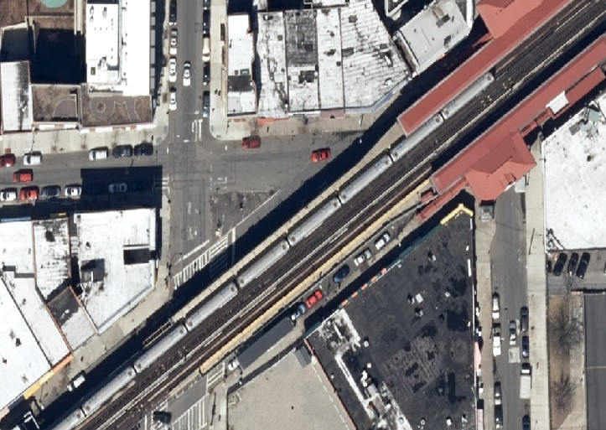
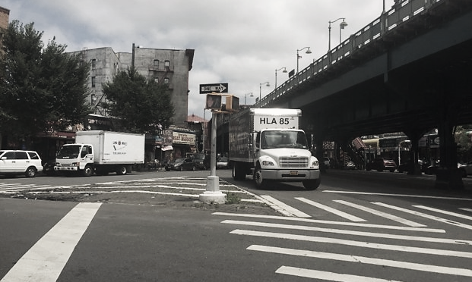
Southern Blvd BID – Simpson St Triangle Pedestrian Plaza
Southern Blvd BID
Stair
Background
Southern Blvd BID
Close to Simpson St subway station
Traffic volume of 165 St between Westchester Ave and Fox St is low (max 169 vehicles/hour in 2017)
Issues
Large empty space
Opportunities
Close 165 St between Westchester Ave and Fox St to create a pedestrian plaza
Simpson St Subway Station
Fox St
2
5
165 St
Southern Blvd BID
Westchester Ave
Stair
Elevator
Southern Blvd BID
Simpson St
Existing
Southern Blvd BID
Stair
Fox St
Simpson St Subway Station
2
5
165 St
Pedestrian Plaza
Southern Blvd BID
Westchester Ave
Stair
Elevator
Striped Empty Space
Southern Blvd BID
Simpson St
Opportunity
Westchester Ave @ Fox St (Facing East)

Slide 29
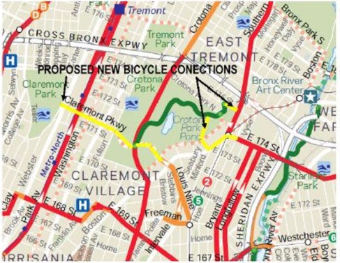
Parks & Open Space
Major parks and open space resources are Crotona Park and Bronx River parks (Starlight Park and Concrete Plant Park)
Future additional three access points to Bronx River parks through Sheridan Enhancement Project
Future better connection between Starlight Park and Concrete Plant Park through Starlight Park Phase II
Crotona & Tremont Park Master Plan 2015 proposed new bike connections
Crotona Pkwy Malls
Claremont Pkwy
175 St
Crotona Park
Proposed Bike Connection by the Master Plan
173 St
Current Access
Boston Rd
Future Access
Starlight Park
Future Access
Bronx River Ave Bike Lane
Future Access
Starlight Park Phase II
Current Access
Current Access
Concrete Plant Park
Current Access
Crotona &Tremont Park Master Plan 2015: https://www.nycgovparks.org/planning-and-building/planning/conceptual-plans/crotona-and-tremont-park-master-plan
29

Slide 30
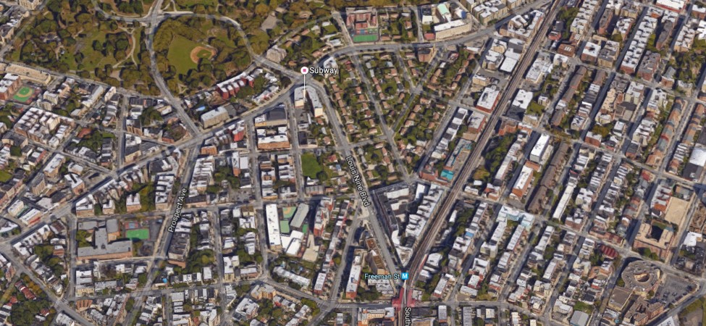
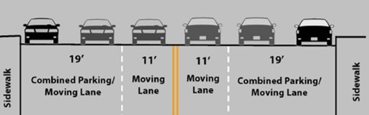
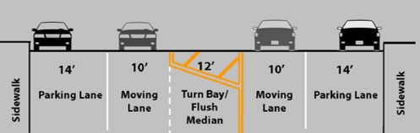
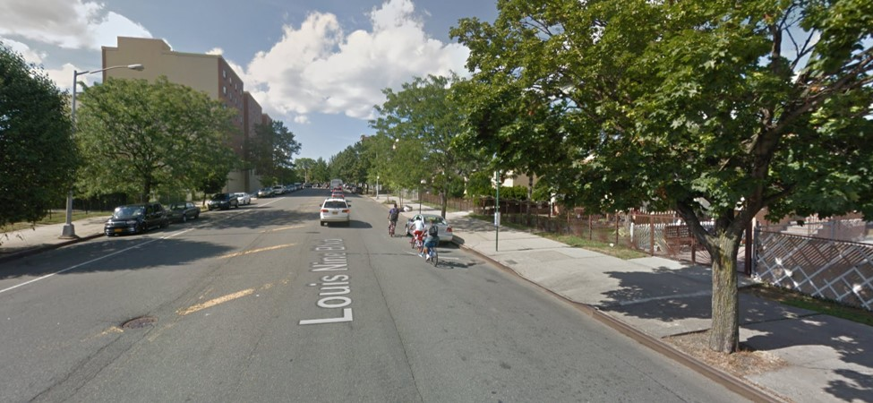
Parks & Open Space – Louis Nine Blvd Connection
Background
Better sense of entrance to Crotona Park compared to 174 St subway station despite longer distance
Signed bike route
Fewer than 400 vehicles/hour/direction during the peak period in 2017
DOT completed project in 2012
New DOT project: Louis Nine Blvd Safety Improvements (NNLOUISNIN)
Project Scope (In-Progress); Construction Registration 2025
Issues
60 feet wide underutilized street
Opportunities
Add standard bike lane by taking 5’ of the 14’ parking lane
Raised median
Crotona Park
Charlotte Garden
Boston Rd
170 St
Louis Nine Blvd
Jennings St
Before
After
2
5
Freeman St Subway Station
Wide On-Street Parking Space
Striped Median
Louis Nine Blvd @ 170 St (Facing North)
Louis Nine and Intervale Safety Improvements Project 2012: http://www.nyc.gov/html/dot/downloads/pdf/2012-06-26-louis-nine-cb3-slides.pdf
Louis Nine and Intervale Safety Improvements After Analysis 2013: http://www.nyc.gov/html/dot/downloads/pdf/dot-report-louis-nine-boulevard-bx.pdf
30

Slide 31
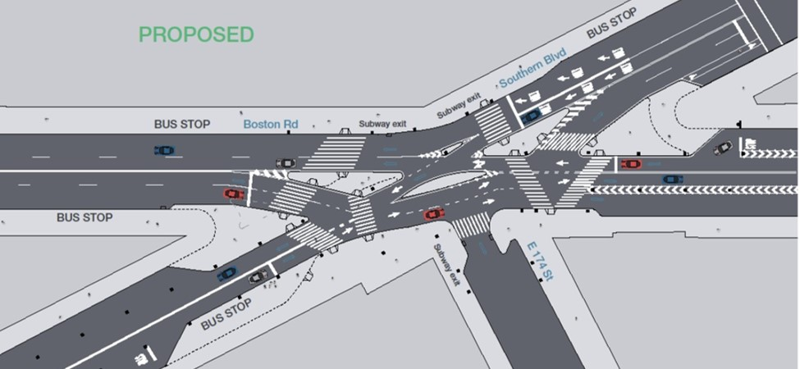
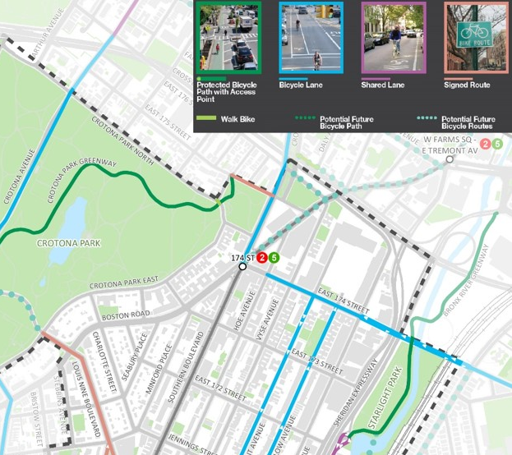

Parks & Open Space – 174 St Connection
Background
Important connection between Crotona Park and Starlight Park
Southern Blvd @ Boston Rd @ 174 St is a Vision Zero Priority Intersection and had a DOT project in 2015 (construction will begin after DDC sewer and water main capital reconstruction)
Issues
No wayfinding for parks
Bike lane gap on 174 St
Missing southbound bike lane on Southern Blvd possibly due to the bus stop
High pedestrian crashes and KSI
Opportunities
Wayfinding signage for parks
Add bike lane on 174 St between Southern Blvd and Hoe Ave
Have two-way bike lanes on the east side of Southern Blvd and better guide the cyclists to connect to the bike network
Pedestrian safety improvements along the 174 St between Southern Blvd and Starlight Park
Missing
SB Bike Lane
Southern Blvd
Boston Rd
174 St
Bike Lane Gap
Proposed Design of Southern Blvd @ Boston Rd @ 174 St
Southern Blvd
Cross Bronx Plaza
Crotona Park
Crotona Park
Cross Bronx Plaza
Boston Rd
Bike Lane Gap
174 St
174 St
Boston Rd
Hoe Ave
Hoe Ave
Vyse Ave
Starlight Park
Southern Blvd
Bryant Ave
Longfellow Ave
Starlight Park
174 St @ Southern Blvd (Facing South)
Southern Blvd & Boston Rd at E174th St Intersection Safety Improvements 2015: http://www.nyc.gov/html/dot/downloads/pdf/2015-03-southern-blvd-boston-rd.pdf
31

Slide 32


Parks & Open Space – Crotona Park East
Background
Crotona Park E between Crotona Park N and Crotona Park E is not a mapped Street
Traffic volume varies a lot (max 615 vehicles/hour in 2017)
Friends of Crotona Park* has suggested closing the segment to better connect Hylan Park and Crotona Park
Issues
Hylan Park is separated from Crotona Park by the unmapped segment
No crosswalk for greenway
No stop sign for Crotona Park E @ Crotona Park N eastbound
Stop sign for Greenway on Hylan Park side but not Crotona Park
Opportunities
Option 1: Close the street (further traffic study needed to see how it would affect traffic flow around the park)
Option 2: Not to close the street but better connect the greenways (stop sign, raised crosswalk, different pavement, etc.)
Option 3: Close the street only on weekends
Crotona Park E
Crotona Park N
175 St
Alternative If Segment Closed
Greenway
No Stop Sign
Stop Sign for Greenway
Hylan Park
Stop Sign
Southern Blvd
Crotona Park
Crotona Park E
Boston Rd
Crotona Park E
174 St
Stop Sign for Greenway
Greenway
Missing Crosswalk
Greenway
Parking Causes Low Visibility
No Stop Sign
Crotona Park E @ Crotona Park N (Facing South)
*Friends of Crotona Park Contact: Shawn Cargil (Shawn.Cargil@parks.nyc.gov)

Slide 33



Parks & Open Space – Horseshoe Park Triangle
Hall Pl
Background
Horseshoe Park with step street
Schools around the park
Issues
Large empty striped space
Opportunities
School maintained public art or murals
Intervale Ave
Horseshoe Park
Stop Sign
Step Street
165 St
Stop Sign
School
Rogers Pl
School
Playground
Step Street
Benches
Large Empty Striped Space
Rogers Pl @ 165 St (Facing West)
David Ellis’s Mural in Pearl Street Triangle in Brooklyn*
*Source: http://www.pbs.org/newshour/updates/urban-designers-transformed-these-five-plazas-into-pedestrian-paradise/
33

Slide 34
Westchester Ave Corridor
Under the el from 163 St to Southern Blvd
70 ft wide street without el from Southern Blvd to Whitlock Ave
High crashes along Westchester Ave
High pedestrian crashes at the intersection of Westchester Ave and Southern Blvd
Crash 2012-2016
KSI* 2012-2016
**
Westchester Ave (163 St to Whitlock Ave)
Crashes | 2012-2016
Total | 323
Pedestrian | 89
Bicycle | 24
KSI* | 2012-2016
Total | 19
Pedestrian | 6
Bicycle | 3
Westchester Ave
Westchester Ave
*KSI = Number of Killed or Severely Injured persons in crashes
**DOT uses pedestrian KSI to identify Vision Zero Priority Intersections, Corridors and Areas

Slide 35


Westchester Ave Corridor – 163 St / Rev James A Polite Ave
163 St
Truck Route
Background
Westchester Ave and 163 St are truck routes
43 crashes between 2012 and 2016
6 collisions with fixed object, structure or barriers
Issues
Columns in the middle of the intersection (unclear which side of columns to drive on)
Downhill from north may cause speeding
Opportunities
Lane assignments for southbound (exclusive left turn)
Markings to guide the vehicles to avoid columns
Under the Els treatment around the Bx4/Bx4A bus stops
Curb extension of the gas station corner (ban the sharp right turn from 163 St to Westchester Ave which had only ~10 vehicles/hour in 2016)
Bx4/Bx4A
162 St
165 vph (PM Peak)
Gas Station
13
163 St
Truck Route
Bx6
23
342
79
Bx4/Bx4A
Westchester Ave
Rev James A Polite Ave
Issues
Opportunities
Bx6
Columns
Buses
Rev James A Polite Ave
163 St (Inner)
163 St (Outer)
Westchester Ave
Westchester Ave
162 St
Left Turn Only
Opportunities for Southbound Lane Assignments
Downhill

Slide 36

Westchester Ave Corridor – Hoe Ave
Background
17 crashes between 2012 and 2016
83% were pedestrian crashes
50% happened when the motor vehicles were making left turns
Recently installed left turn treatments
Bx5 (articulated) uses the slip to turn around
Issues
70-75 feet long pedestrian crossing
Opportunities
Curb extensions on Westchester Ave to shorten the long pedestrian crossings
Westchester Ave
West Farms Rd
Curb Extensions
70 Feet Long Pedestrian Crossing
75 Feet Long Pedestrian Crossing
165 St
Bx5
Hoe Ave

Slide 37



Westchester Ave Corridor – Longfellow Ave / 167 St
Background
26 crashes between 2012 and 2016
31% were pedestrian crashes
54% of all crashes were motor vehicle crashes, within which 43% were rear end collisions
Issues
78-86 feet long pedestrian crossing
Pedestrian signal blocked by streetlight pole
Opportunities
Ban the right turn from 167 St to Westchester Ave (max 4 vehicles/hour in 2017)
Curb extensions to shorten the long pedestrian crossings
Adjust the position of pedestrian signal
Bryant Ave
Blocked Pedestrian Signal
Westchester Ave
78 Feet Long Pedestrian Crossing
85 Feet Long Pedestrian Crossing
167 St
86 Feet Long Pedestrian Crossing
Longfellow Ave
78 Feet Long Pedestrian Crossing
85 Feet Long Pedestrian Crossing
Pedestrian Signal Blocked by Streetlight Pole
86 Feet Long Pedestrian Crossing
Westchester Ave @ 167 St (Facing East)
167 St @ Westchester Ave (Facing East)

Slide 38


Westchester Ave Corridor – Longfellow Ave / 167 St
Existing
Opportunity
78 ft
45 ft
86 ft
56 ft

Slide 39


Westchester Ave Corridor – Whitlock Ave
Proposed Improvements in 2013 Project
Background
40 crashes between 2012 and 2016
5 bicycle crashes and 4 pedestrian crashes
12 crashes were either overtaking or rear end
DOT completed project in 2013
New DOT project: Westchester Avenue and Whitlock Avenue Pedestrian Safety Improvements (NN-XWHIT)
Project Scope (In-Progress); construction registration 2020
Issues
Potential speeding issue
Zigzagging to avoid the column in the middle of intersection
Opportunities
Markings to guide vehicles on Whitlock Ave
Speed limit signs
Enforcement
Faded / Not Done
Whitlock Ave @ Westchester Ave (Facing North)
Bronx River Greenway Southern Connections 2013: http://www.nyc.gov/html/dot/downloads/pdf/2013-01-bronx-river-greenway-cb2.pdf

Slide 40


Westchester Ave Corridor – Whitlock Ave (Freeman St / Boone Ave)
Background
Sheridan exit ramp, Boone Ave, and Freeman St merge into Whitlock Ave
No stop sign on exit ramp
Stop signs on both Boone Ave and Freeman St
Issues
Large intersection without crosswalks
Confusing traffic flows for the merging
Opportunities
Add crosswalks
Curb extension to narrow down the intersection and regulate the traffic flows
School
Sheridan Exit Ramp
Boone Ave
Freeman St
Westchester Ave
Whitlock Ave
Concrete Plant Park
Large Intersection with missing crosswalks and confusing traffic flows
Boone Ave @ Freeman St @ Whitlock Ave (Facing South)

